Slide 1

Airbnb Data Analysis
Presented by Samarth Singh

Slide 2
Introduction
As a BI Analyst, I'm exploring Airbnb's data to understand user experiences. This involves analyzing district location scores, studying the link between host response times and overall ratings, and visualizing Airbnb listing prices. I'll also assess composite scores, listing age, and host tenure. The main objective is to comprehensively analyze listing prices, guest ratings, and visitor trends, particularly focusing on notable changes in 2020. This initiative aims to offer a professional perspective on Airbnb's data dynamics.

Slide 3
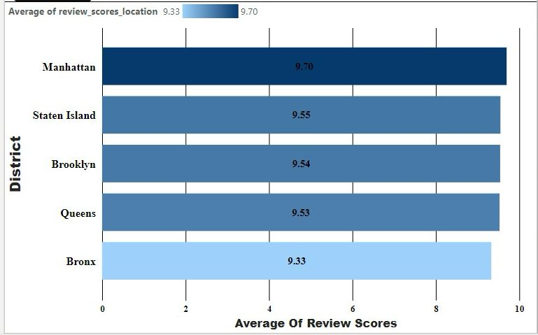
Evaluating District Location Scores
Examining district location scores, the Bronx stands out with the lowest score at 9.33, signaling a need for improvement. This insight is vital for hosts and Airbnb stakeholders seeking areas to enhance. Although Manhattan leads with a score of 9.70, addressing concerns in the Bronx can boost overall competitiveness. Targeted improvements in the Bronx can enhance guest satisfaction, positively impacting the district's reputation and desirability.

Slide 4
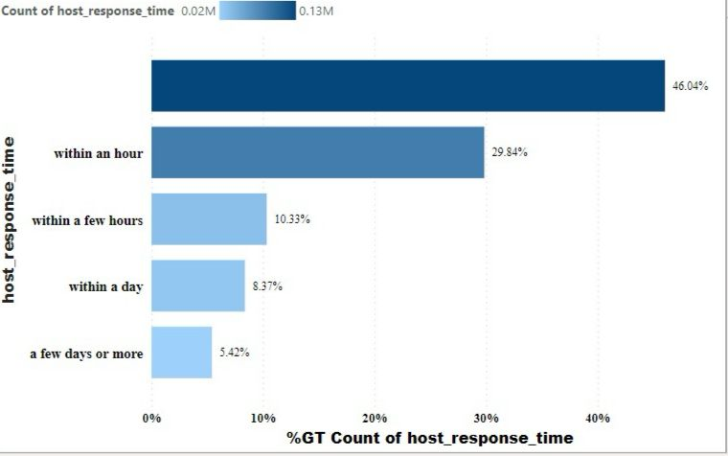
Analyzing the Influence of Host Response Times:
46.04% of Airbnb listings lack specified response times, highlighting communication variability. Quick responses 'within an hour' are prioritized by 29.84%, while 'within a few hours' and 'within a day' represent 10.33% and 8.37%, respectively. About 5.42% indicate longer response times, potentially affecting guest satisfaction. The link between host response times and ratings warrants exploration, with swift responses likely enhancing ratings and clear communication expectations improving the overall guest experience.

Slide 5
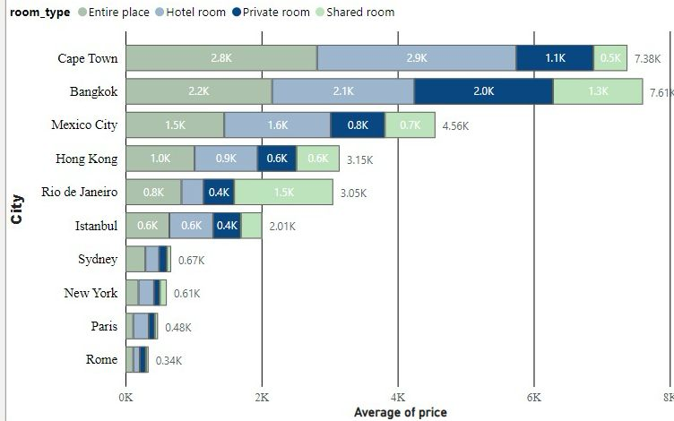
Examining Listing Prices in Global Cities: Patterns and Perspectives
Cape Town has the highest prices for Entire place and Hotel room, while Bangkok leads in Private room and Shared room rates. Paris generally has lower average prices for all room types. Hong Kong and Sydney show notable price variations, and Rio de Janeiro highlights a significant difference between Entire place and Hotel room rates. Shared rooms are budget-friendly, while Entire place and Hotel room options tend to be pricier. Diverse pricing patterns are evident in cities like Cape Town and Bangkok. Paris and New York generally have lower prices across all room types, while Rio de Janeiro has a relatively lower price for Entire place.

Slide 6
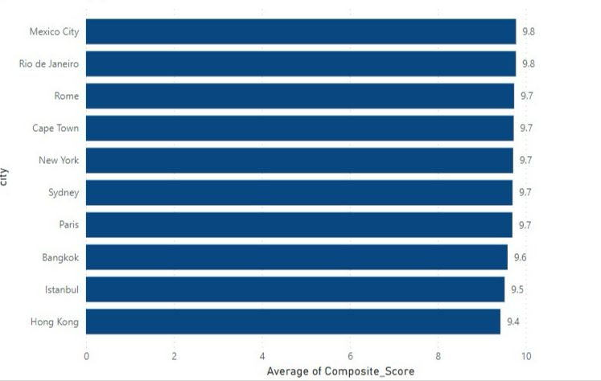
Comparing Airbnb Composite Scores for Check-in and Communication:
Staten Island uses a basic mean calculation for check-in and communication scores, resulting in the highest composite score of 9.81, highlighting exceptional integration. Brooklyn closely follows with a notable 9.77 score, indicating a consistently positive trend in composite scores. The Bronx and Queens also display commendable scores of 9.71 and 9.68, respectively, signaling competitive performance in guest satisfaction. Although slightly lower, Manhattan maintains a solid average composite score of 9.67, emphasizing a high standard in check-in experience and host communication.

Slide 7
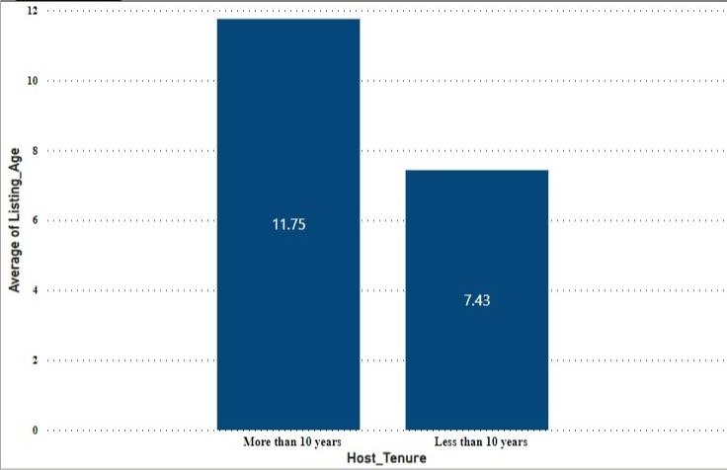
Trend Analysis for Listing Age and Host Tenure
To calculate Listing Age and identify hosts with over ten years of experience, create a "Listing_Age" column in the "Data" view using DAX: `DATEDIFF([host_since], TODAY(), YEAR)`. Add a "Host_Tenure" column with DAX: `IF(DATEDIFF([host_since], TODAY(), YEAR) > 10, "More than 10 years", "Less than 10 years")`.
Analysis shows hosts with over 10 years of tenure have an average listing age of 11.75 years, reflecting a stable presence. Hosts with less than 10 years average 7.43 years, indicating a newer Airbnb presence. This correlation between hosting experience and listing age provides valuable insights.

Slide 8
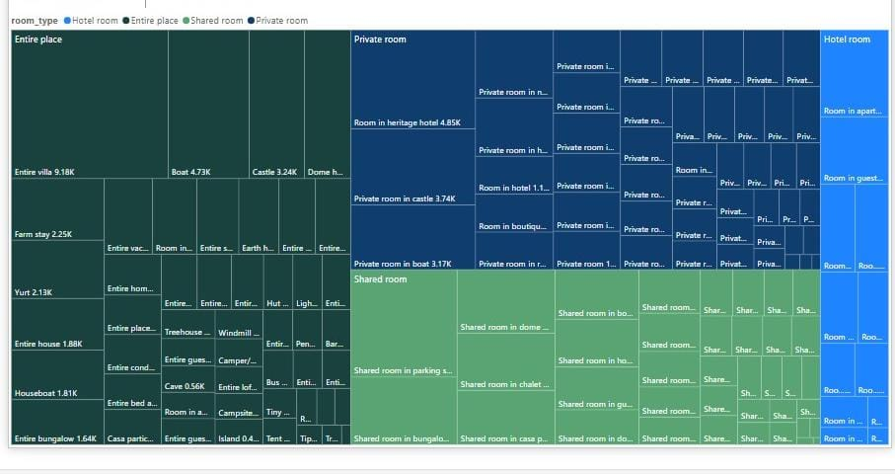
Interpreting Prices Across Property Types
In the "Entire Place" category, "Entire villa" commands the highest average price at 9.18K USD. A visual tree map succinctly illustrates price distribution for different room and property types. The emphasis on "Entire villa" highlights its affiliation with upscale accommodations, providing valuable insights for hosts and guests. This data supports hosts in pricing strategies and helps guests choose accommodations that match their preferences and budget.

Slide 9
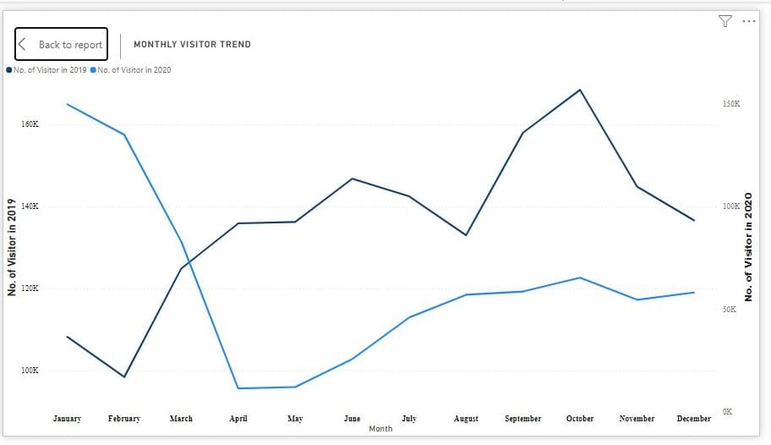
Visitor Trends: 2019–2020 Comparative Study
Visitor counts rose from January to March in 2019, but this growth was disrupted in March 2020. Subsequent months in 2020 saw a notable decline, particularly in June, reflecting the impact of the COVID-19 pandemic on reduced travel. While September 2020 showed a slight recovery, overall visitor numbers remained below the corresponding months in 2019.

Slide 10

Conclusion
The examination of Airbnb data provides valuable insights across various aspects. Seasonal trends in monthly visitors reveal heightened activity in the summer, presenting opportunities for targeted marketing efforts. Diverse guest ratings across cities like Mexico City and Rio de Janeiro underscore the influence on tourism, emphasizing the need for continuous monitoring. Analysis of average listing prices indicates a spectrum from high-cost cities like Cape Town to more budget-friendly destinations like Sydney, underscoring the significance of market dynamics and strategic adjustments. Overall, a comprehensive approach involving year-to-year comparisons, data quality checks, and feedback loops is essential for ensuring Airbnb's sustained success in the competitive hospitality industry.

